Slide 1


Insider Threat at Yahoo
Yahoo, the renowned internet company, fell victim to a devastating insider threat when a malicious employee stole sensitive intellectual property, threatening the company's competitive edge and reputation.

Slide 2

Background on Yahoo and its business
Yahoo was once a leading internet company, founded in 1994 and known for its pioneering web portal, search engine, and suite of online services. As a major player in the tech industry, Yahoo's business revolved around the collection, organization, and monetization of vast amounts of user data and intellectual property.

Slide 3
Importance of Intellectual Property (IP) to Yahoo
1
Key Asset for Technology Company
2
Fueling Product Innovations
As a prominent technology company, Yahoo's intellectual property, including patents, trade secrets, and innovative software, was critical to its competitive advantage and long-term success.
Yahoo's IP protected the innovative work of its engineers and researchers, enabling the company to develop new products and features that delighted users and drove revenue growth.
3
Protecting Brand and Reputation
4
Generating Licensing Revenue
Yahoo's trademarks, copyrights, and other IP assets helped the company maintain its brand identity and reputation as a trusted online destination for millions of users worldwide.
Yahoo's IP portfolio also served as a source of licensing revenue, as the company monetized its innovations through strategic partnerships and technology licensing agreements.

Slide 4

How a Malicious Insider Gained Access to Yahoo's IP
The malicious insider, a disgruntled former Yahoo employee, leveraged their knowledge of the company's internal systems and security protocols to gain unauthorized access to the organization's sensitive intellectual property (IP) repositories. They exploited vulnerabilities in the access control and logging mechanisms to cover their tracks.

Slide 5




Techniques used by the insider to steal the IP
Exploiting Insider Access
The malicious insider leveraged their privileged access within Yahoo to gain unauthorized entry into the company's secure systems and databases containing valuable intellectual property.
Covert Data Extraction
Using sophisticated techniques, the insider siphoned off sensitive documents, patents, and trade secrets without leaving any obvious traces of the theft.
Covering Their Tracks
The insider carefully covered their digital footprints, manipulating log files and concealing evidence of the IP theft to avoid detection for as long as possible.

Slide 6

Impact of the IP Theft on Yahoo's Business
The theft of Yahoo's intellectual property had a devastating impact on the company's business. The stolen trade secrets and proprietary technology gave competitors an unfair advantage, allowing them to rapidly develop similar products and undercut Yahoo's market share.
This erosion of Yahoo's competitive edge resulted in significant revenue losses and damaged the company's reputation as an innovative technology leader.

Slide 7
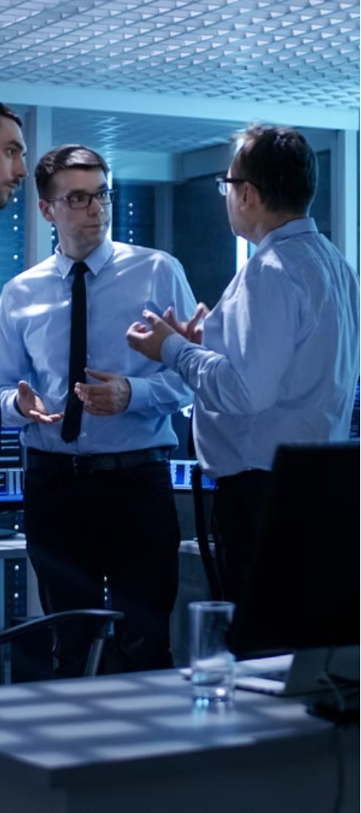
Yahoo's Response and Investigation
1
Immediate Action
Yahoo acted swiftly, launching an internal investigation to determine the extent of the data breach and identify the perpetrator.
2
Forensic Analysis
Cybersecurity experts conducted a thorough forensic analysis of Yahoo's systems, gathering evidence and tracing the attacker's activities.
3
Collaboration with Authorities
Yahoo cooperated closely with law enforcement agencies, sharing intelligence and evidence to aid the criminal investigation.

Slide 8
Lessons Learned from the Incident
Insider Threat Awareness
Privileged Access Monitoring
The incident highlighted the need for heightened insider threat awareness within the organization. Security protocols must be reviewed and strengthened.
The malicious insider exploited privileged access to sensitive data. Implementing robust access controls and monitoring systems is crucial.
Security Culture Shift
Data Encryption and Backup
The breach underscored the importance of fostering a strong security culture where employees are vigilant and report suspicious activities.
Ensuring critical intellectual property is properly encrypted and backed up can mitigate the impact of future insider threats.

Slide 9



Measures to Prevent Future Insider Threats
Robust Access Controls
1
Implement strong authentication and authorization measures to limit access to sensitive data.
Continuous Monitoring
2
Deploy tools to detect anomalous user behavior and flag potential insider threats.
Employee Education
3
Train staff on identifying and reporting suspicious activities to mitigate insider risks.
To prevent future insider threats like the one at Yahoo, organizations must take a proactive, multi-layered approach. This includes robust access controls, continuous monitoring of user activities, and comprehensive employee education programs to foster a security-conscious culture. By addressing both technical and human factors, companies can better safeguard their valuable intellectual property.

Slide 10

Conclusion and key takeaways
The insider threat at Yahoo underscores the importance of robust cybersecurity measures and employee monitoring to protect valuable intellectual property.
Implementing stringent access controls, user activity monitoring, and regular security audits can help detect and mitigate insider threats before they cause significant damage.
Fostering a security-conscious culture, providing regular security training, and empowering employees to report suspicious activities are crucial in preventing similar incidents in the future.

